Slide 1





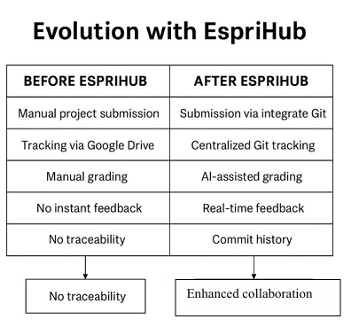
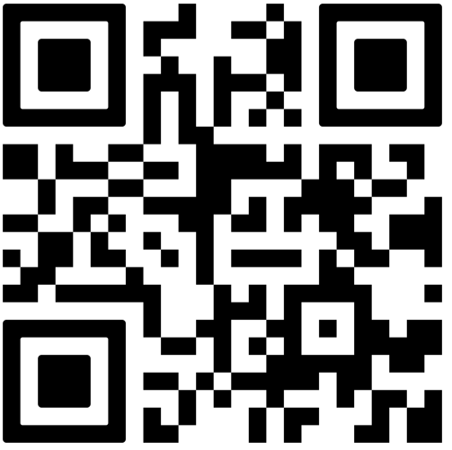
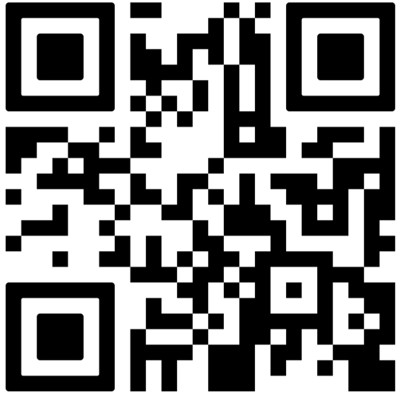
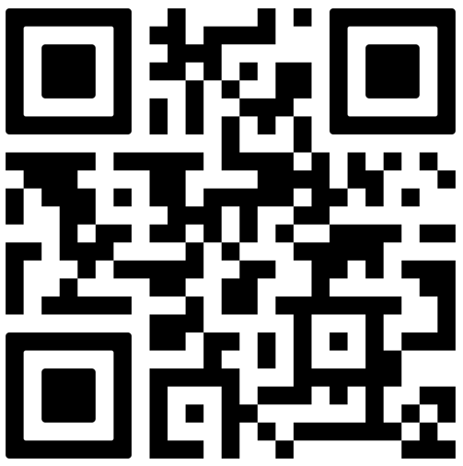
EspriHub: A Git-based Academic Platform for Project and Evaluation Management
POSTER ID27
Author Name¹, Co-Author Name², Third Author¹
contact@esprit.tn, contact@esprit.tn, contact@esprit.tn
ESPRIT School of Business¹, ESPRIT School of Engineering
1
Context & Problem
Project-based learning is central to engineering education at Esprit University, involving large cohorts of students working collaboratively on software projects. While platforms such as GitHub and GitLab are widely used for version control, they are not designed for academic evaluation workflows. Teachers face fragmented processes for repository creation, submission tracking, contribution monitoring, and grading. These limitations increase administrative workload and reduce assessment transparency. EspriHub is a platform that integrate software development tools with institutional structures, pedagogical requirements, and scalable evaluation mechanisms.
2
Research Problem: Importance & Relevance
3
Approach & Methodology
Reduces manual repository creation, submission tracking, and monitoring workload
Improves feedback timeliness, transparency, and visibility of individual contributions
Supports scalable management of project-based learning in high-enrollment programmes.
Leverages AI-assisted evaluation while preserving human decision-making
EspriHub aligns with the future-oriented agenda of building efficient, intelligent, and human-centered higher education systems.
Preferred formats: diagram · workflow · pedagogical schema — avoid dense text.
[ Insert: Diagram / Workflow / Pedagogical Schema / AI Tools Map ]
4
Innovation & Contribution ⭐ — What is new?
Pedagogical Innovation
Scientific Contribution
Originality vs. Existing Practice
Integrating version control enables transparent assessment in project-based learning. It improves the visibility of individual contributions within group projects.
An AI-enabled academic Git platform that bridges software engineering tools with pedagogy while offering insights into scalable academic project management.
Unlike GitHub or GitLab, EspriHub natively supports academic structures, automated submissions, deadline enforcement, and AI-powered grading assistance tailored to higher education.
5
Results & Evidence
6
Implications & Best Practices
Early-stage work: preliminary observations, student feedback, prototype.
Practice-based work: results, impact metrics, concrete examples.
Start with institutional alignment before technical deployment
Maintain human-in-the-loop for AI-based grading
Ensure clear role definitions and access control
Easily transferable to other engineering programs
Use dashboards ti support both formative and summative assessement
Design for scalability , especially in programmes with large numbers of project-based courses
[ Chart · Table · Key Metrics · Student Quotes ]
7
Ethical & Responsible AI Considerations
8
Key Takeaways
AI provides recommendations, not final grades
Transparency in evaluation criteria and data usage
Protection of student data and privacy (internal hosting)
Mitigation of bias through teacher validation
Clear communication and consent regarding AI use
🔑 EspriHub shows how AI may significantly improve academic assessment without taking the place of teachers
🎯 Reduces faculty workload in large project-based course ✅ Improves fairness and traceability of assessment 🔁 Transferable to other universities and training contexts 🌱 Supports a sustainable vision of the AI-enabled University of the Future
9
References
10
Scan for More
[1] Dabbish, L., Stuart, C., Tsay, J., & Herbsleb, J. (2012). Social coding in GitHub: Transparency and collaboration in an open software repository
[2] Holmes, W., Bialik, M., & Fadel, C. (2019). Artificial Intelligence in Education: Promises and Implications for Teaching and Learning. Center for Curriculum Redesign
[3] Luckin, R., Holmes, W., Griffiths, M., & Forcier, L. B. (2016). Intelligence Unleashed: An argument for AI in Education. Pearson.
[4] Zawacki-Richter, O., Marín, V. I., Bond, M., & Gouverneur, F. (2019). Systematic review of research on artificial intelligence applications in higher education.
QR
QR
QR
Extended
Abstract
Slides /
Demo
Full Paper
or Dataset
WEITA 2026 • April 17–18, 2026 • Tunis, Tunisia
AI and the University of the Future: Shaping Sustainable Impact

